Slide 1
The impact of EU price rules:
Interchange fee regulation in retail payments
CEPS-ECRI Working paper
Willem Pieter de Groen

Slide 2
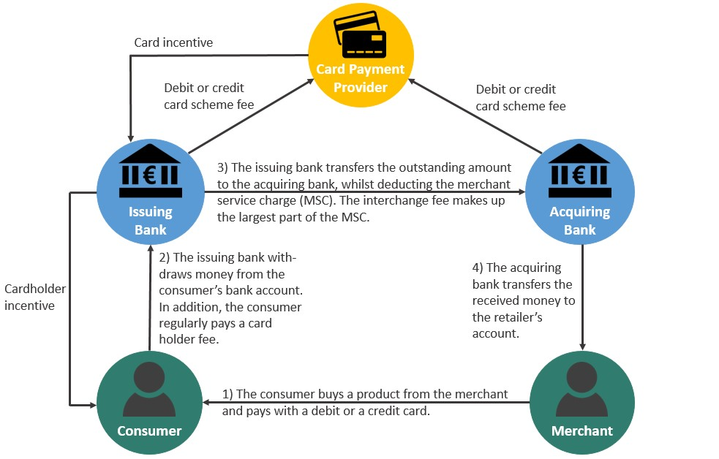
Four-party scheme
Scheme fee
Card scheme
Scheme fee
€
Issuer
Acquirer
Interchange fee
€
€
Merchant Service Charge
Card holder fee /
Card incentives
Cardholder
Merchant

Slide 3
Interchange Fee Regulation (2015)
Aims to facilitate secure, efficient, competitive and innovative payments
Cap on consumer card interchange fees (0.2% debit card, 0.3% credit cards)
  Commercial cards and interregional card transactions are exempted
No restrictions on co-badging
No requirement to honour all cards for merchants, except for IFR price-regulated cards

Slide 4
Debit card interchange fees pre- and post IFR

Slide 5
Merchant charges (Interchange++, blended, payment package)
Credit card
(International four party scheme)
Debit card
(International four party scheme)
Debit card
(National four party scheme)
Acquirer fees
Acquirer fees
Merchant Service Charge
Variable costs
Scheme fees + X*
Scheme fees + X*
Acquirer fees
Scheme fees + X*
Interchange fee
(≤0.30%)
Interchange fee (≤0.20%)
Interchange fee (≤0.20%)
Fixed costs
Terminal costs (purchase or rental)
One-off costs
Installation and activation costs
*E.g. Processing integrity fee, acceptance development fee, dispute administration fee, card not present unsecure chargeback fee.

Slide 6
Revenues of international card schemes

Slide 7
Conclusions & policy recommendations
Interchange fees reduced in nearly all countries
  Mostly at maximum level (except for at least 7 MS)
Merchant service charges seemed to have decreased with largely the same amount (e.g. BE, IT)
  Comparison difficult due to different fees structures and complexity in fees
Potential partially offset by higher scheme fees
Cardholder fees increased
Continue assessing the impact of the IFR
More transparency (interchange fees, scheme fees, scheme fees and card acceptance fees)
Continued monitoring of the payments sector (market structure and practices)

Slide 8

Thank you!
Thank you!
Willem Pieter DE GROEN
willem.pieter.degroen@ceps.eu
+32 2 229 39 57

